Slide 1
Japanese restaurant opening

Slide 2
Problem
A family wants to open a Japanese restaurant in Toronto.
They want loyal local clientele in a highly populated area.
The criteria for selecting a perfect neighbourhood are:
Population Density
No Japanese restaurants in neighbourhood yet
Little/no other restaurants to restrict the choices of customers
Other venues around that aren’t restaurants to attract people

Slide 3
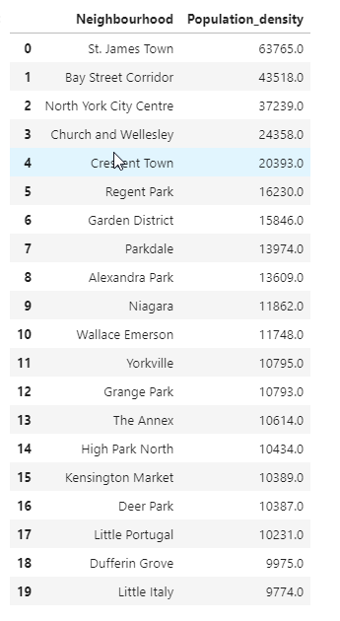
Population Density
The data for population density by neighbourhood in Toronto was scraped from https://en.wikipedia.org/wiki/Demographics_of_Toronto_neighbourhoods . This data was then refined to the top 20 most densely populated neighbourhoods.

Slide 4
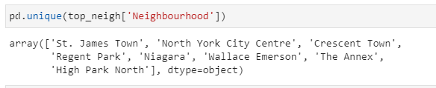
No Japanese restaurants
The venues in these neighbourhoods were found using Foursquare API and the neighbourhoods were then restricted to the neighbourhoods that didn’t have venues of the ‘Japanese restaurant type (see below).

Slide 5
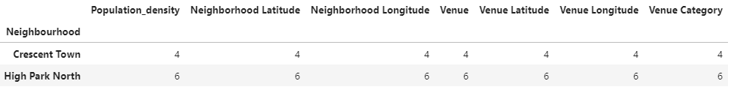
No other restaurants
After this data was examined for restaurants of other types and two neighbourhoods were found to have no restaurants in them. These neighbourhoods were Crescent Town and High Park North. In these two neighbourhoods the venue count was examined to see how many points of interest there are that might attract people to it and High Park North had more.

Slide 6
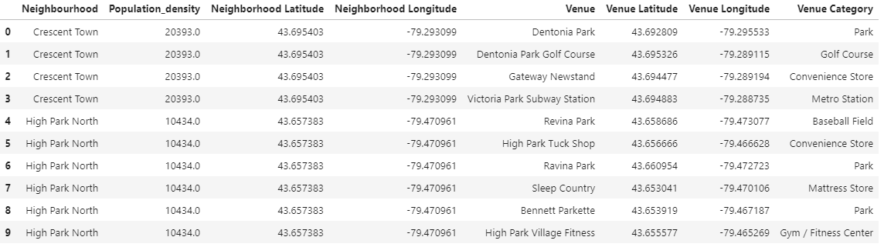
Argument for Crescent Town
When you look at the population density Crescent Town had twice as many people/km2, which would likely contribute more to the restaurant’s popularity than two extra venues that can be found in High Park North.

Slide 7
Recommendation
Based on the criteria discussed the recommendation for a local Japanese restaurant with a loyal local clientele would be to open in Crescent Town.

